Slide 1
What does ownership of development mean for churches and NGO’s and for the constituencies in CEE and in WE”?
Pupazan Vitalie

Slide 2
Introduction
Motivational
Dependency tends toward a loss of “responsibility”.
Dependency creates preoccupation with external source.
Dependency perpetuates the mindset of “poverty”.

Slide 3
Economic
Foreign funding creates a vulnerability to the foreign economy.
Foreign funding often means dependence on a single source.

Slide 4
Preparation stage
Trusting relationship.
Awareness of the need for change.
Specific knowledge.

Slide 5
NGO’s are accountable to their communities
NGOs are mission-based organizations
NGOs promote the highest professional and christian principles
NGOs exercise responsible resource management and
Mobilization.
NGOs are responsive to the communities they serve
Notes:
- Being accountable means demonstrating regularly that it uses its resources wisely and doesn’t take advantages of its special privileges to pursue activities contrary to its nonprofit status.
One of the basic responsibility of the board is to identify, articulate, safeguard and promote the NGO’s mission.
NGO’s are expected to demonstrate a commitment to the community, members or other stakeholders that goes beyond the mission and is on display in exemplary behavior through the organization.
The board will keep an eye to the problematical signs too

Slide 6
Good governance has a formal structure
Good governance involves the separation of governance and management.

Slide 7
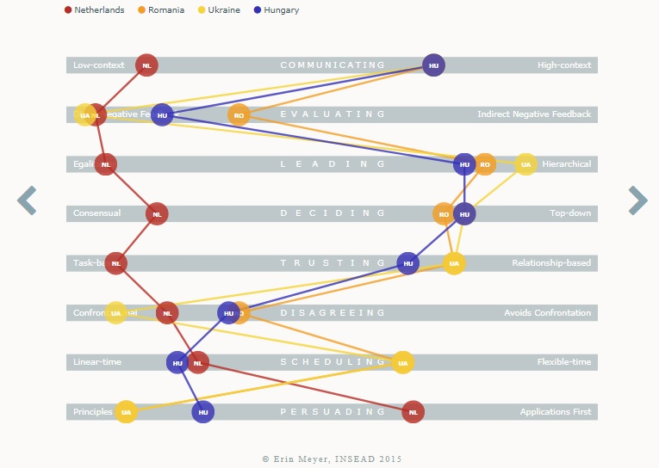

Slide 8
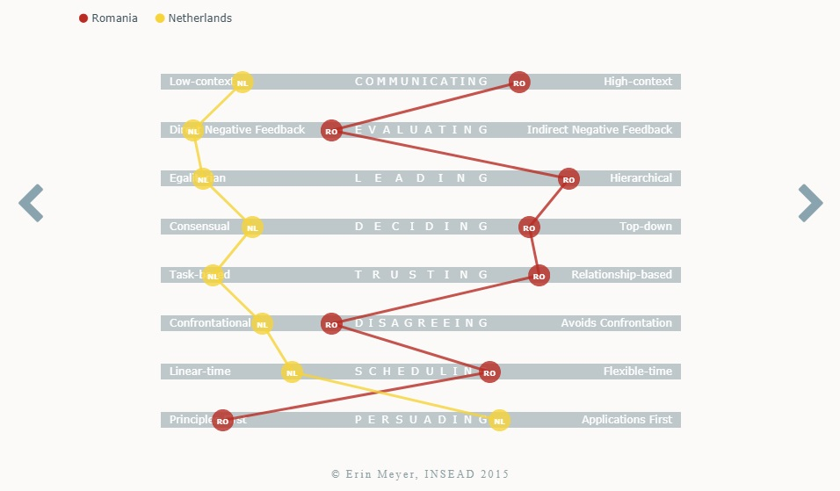

Slide 9
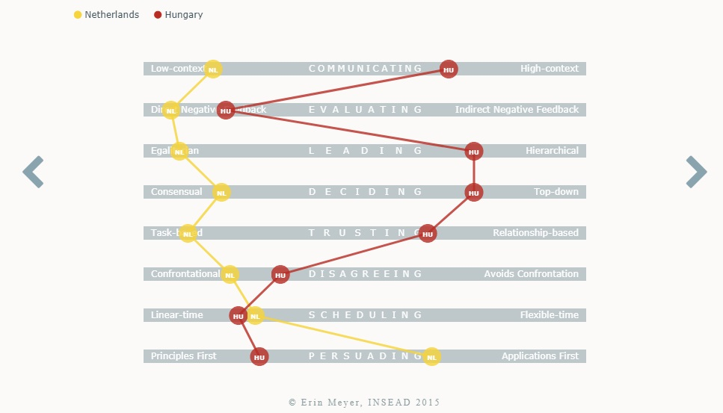

Slide 10
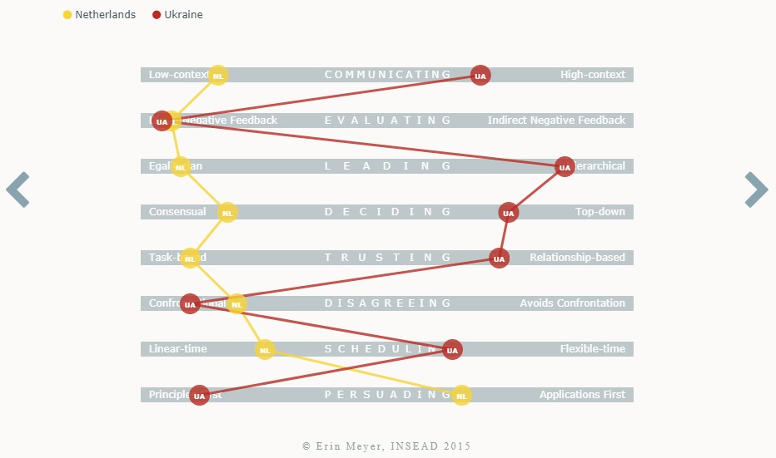

Slide 11
Example.
Compliance | Consultation | Cooperation | Co-learning | Community initiated.
1999-2004 Enthusiasm | 2004-2008 Projects in partnership with churches. | 2008 – 2011 Building strategies together. External evaluation. Decreasing financial support. | 2011 – 2014 Staff Training New partners Large network of local partners | 2014 - … Planning Reporting; Fundraising Local Board Initiating local and foreign cooperation.

Slide 12
Response
Jan Migchels

Slide 13
What does ownership means for churches and NGO’s and the constituencies in CEE and WE?
a response of Jan Migchels

Slide 14
Key Words
ownership
development
Local responsability
proces
leadership
change
Faith instead of money
different
usefull
painfull
preparation

Slide 15
Tough issue
Multi issue versus Single issue
Complex situation
Problem based versus solution search
Personal issues instead personal relations
Internal focus versus external openness
Roles en rules directed
Operation is leading
Control is powerfull
Knowing instead learning
Conservative versus growth
Solving Tough issues:
Step by step
Development
Make little pieces
Ungoing proces
Direction guided

Slide 16
5 forces for change
Leadership
Urgency
Interaction
Ambition
Planning
Pushing force
Driving force
Pulling force

Slide 17
to develope ownership
Strategic give up your pocessings
Tactical leadership, the brain of the organisation
Operational between dynamics and support

Slide 18
Between dynamics and support
Create a social-safe environnement
Create clear positions and mandates
Offer adequate support equipement
Facilitate the learning proces
Make experiments
Offer coaching
Appreciate each others commitment

